Slide 1
Task 3 Dashboard
File created on: 2/8/2022 5:51:55 PM
Created By: Ashwin NS

Slide 2
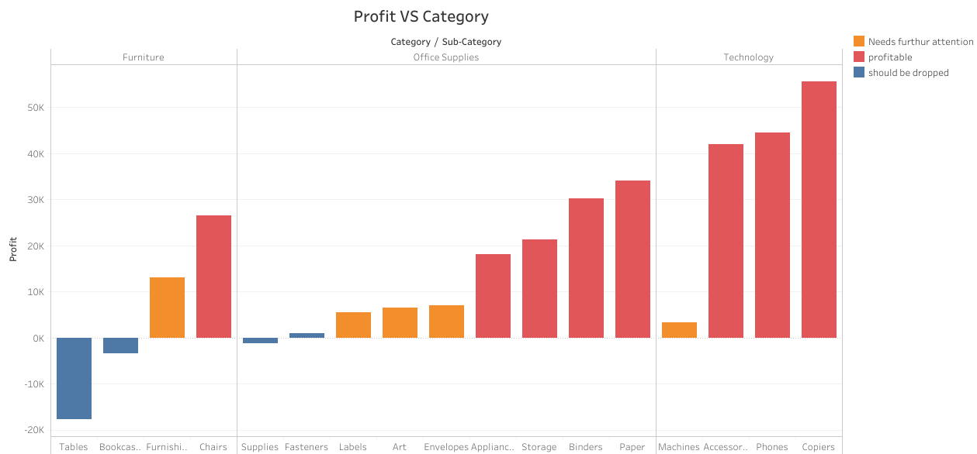

Slide 3
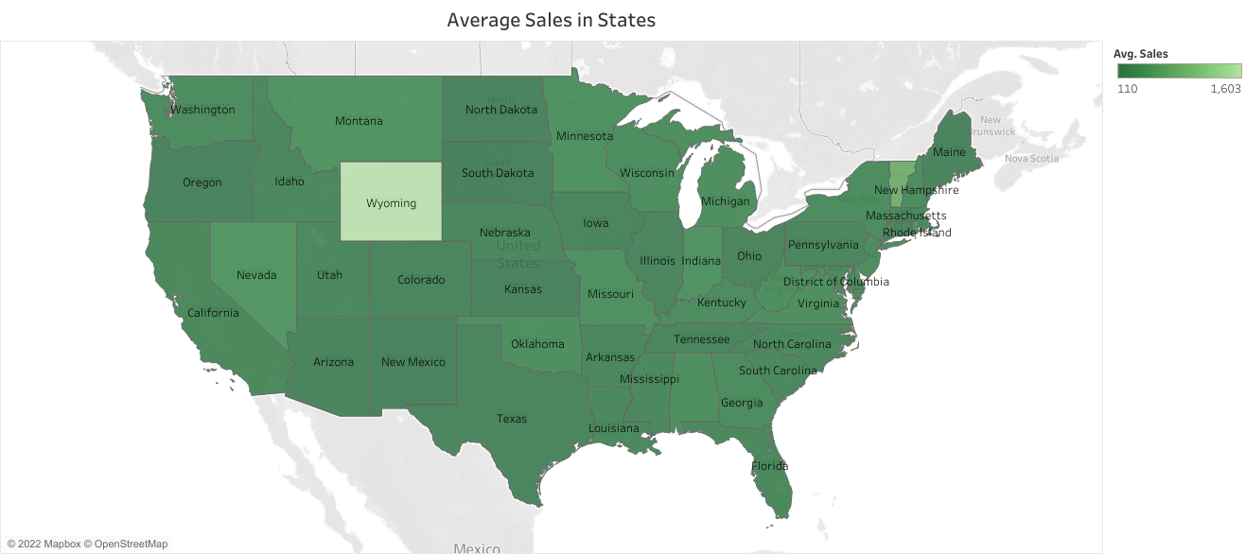

Slide 4
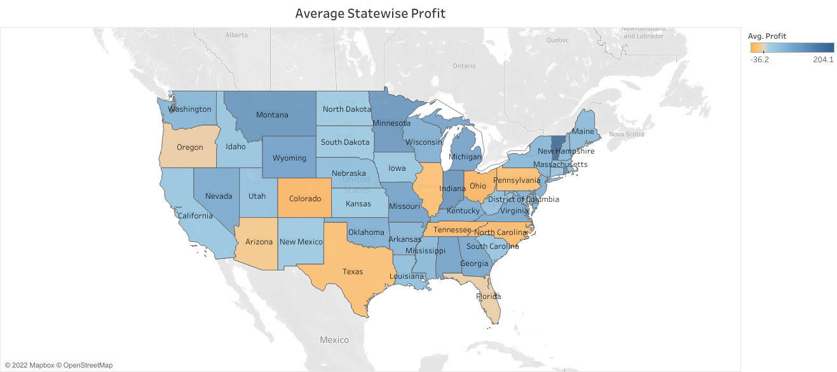

Slide 5
